Slide 1


Applied Cryptography
Ms. Swati Mali
B-215
swatimali@gmail.com
Assistant Professor, Department of Computer Engineering
K. J. Somaiya College of Engineering
Somaiya Vidyavihar University

Slide 2
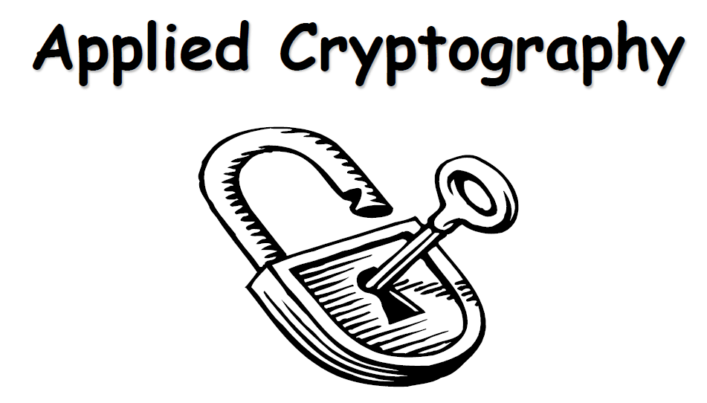

Slide 3
What is this course about?
Objectives
  Security needs / threats
  Security Goals
  Cryptography

Slide 4
Attacks, Services and Mechanisms
Security Attack: Any action that compromises the security of information.
Security Mechanism: A mechanism that is designed to detect, prevent, or recover from a security attack.
Security Service: A service that enhances the security of data processing systems and information transfers. A security service makes use of one or more security mechanisms.

Slide 5
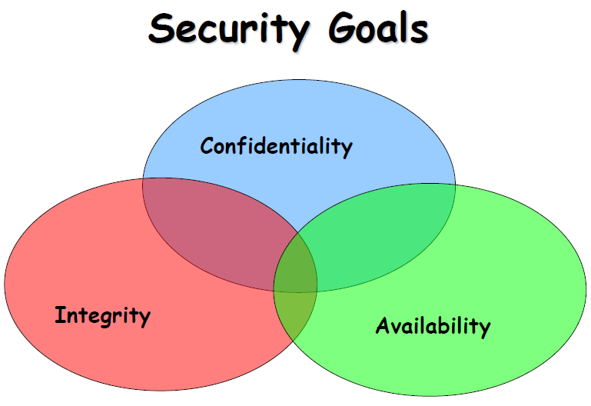
Books

Slide 6
Other A’s
Authentication
Authorization
Access control

Slide 7
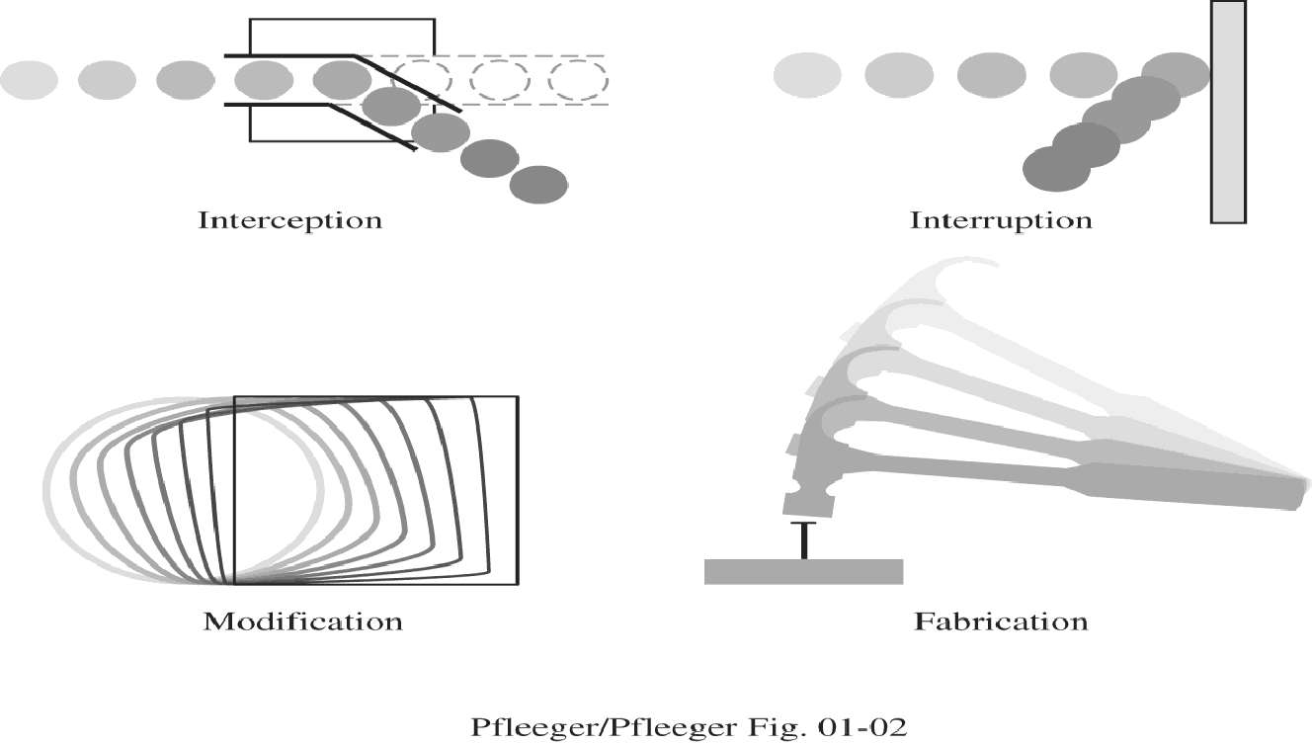

Slide 8
Security Attacks
Interruption: This is an attack on availability, confidentiality
Interception: This is an attack on confidentiality
Modification: This is an attack on integrity
Fabrication: This is an attack on authenticity

Slide 9
Classical – common attacks
Classical attacks on security:
  Eavesdropping
  Traffic Analysis attack
  Replay attack
  non-repudiation attack
  Man-in-the-Middle attack
  Data Tampering
  Denial of Service (DoS) attack
  Brute Force Attack
  zero day exploit attack,
  Phishing and social engineering
  Spoofing
  Malware
  session hijacking attack

Slide 10
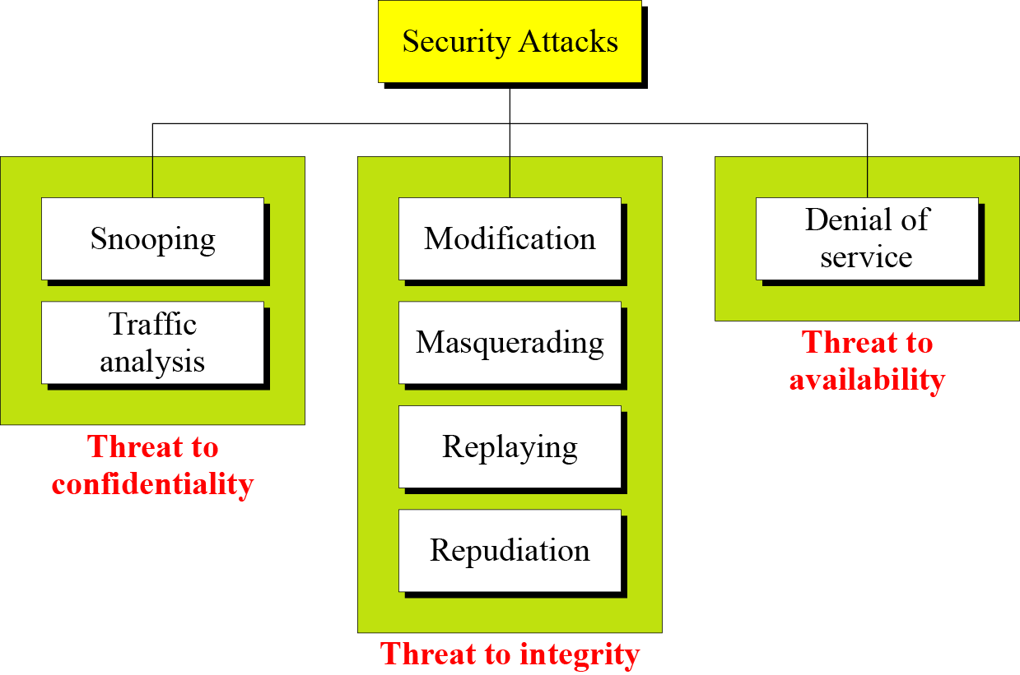

Slide 11
Attacks
Cryptanalytic Attacks
  Exploit mathematical weakness of cryptographic algorithm
Non-cryptanalytic Attacks
  Threats to goal of security

Slide 12
Method, Opportunity and Motive
Method : the skills, knowledge, tools and other things with which to be able to pull off the attack
Opportunity : the time and access to accomplish the attack
Motive : a reason to want to perform this attack against this system
DENY ANY OF THESE THREE THINGS AND
ATTACKS WILL NOT OCCUR

Slide 13
Security Services
Confidentiality (privacy)
Authentication (who created or sent the data)
Integrity (has not been altered)
Non-repudiation (the order is final)
Access control (prevent misuse of resources)
Availability (permanence, non-erasure)
  Denial of Service Attacks
  Virus that deletes files

Slide 14
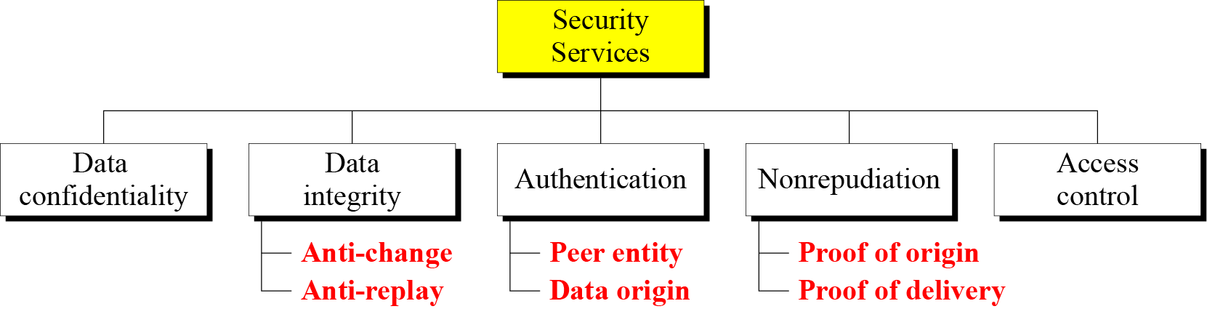

Slide 15
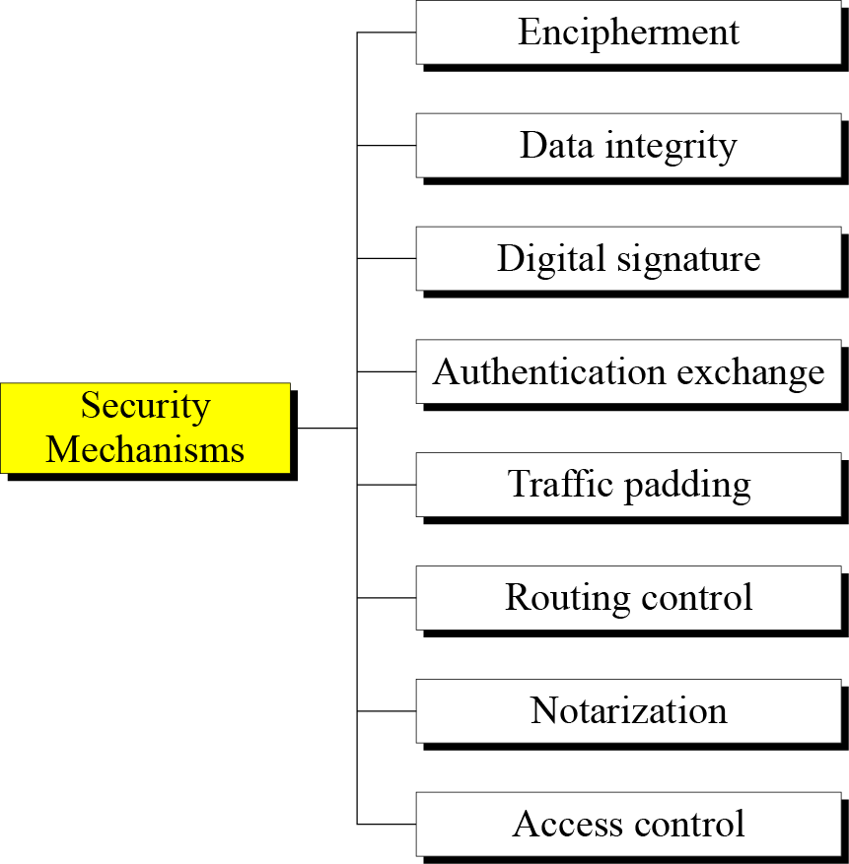

Slide 16
Vulnerabilities
Hardware vulnerabilities
Software vulnerabilities
  Software deletion
  Software modification
    Viruses etc.
  Software theft
Unauthorized copying etc.
Data vulnerabilities

Slide 17
Computer Criminals
Amateurs
  Personal works
Crackers
  Trying to access computing facilities for which they are not authorized
  The perception that nobody is hurt or even endangered by a little stolen machine time
  Others attack for curiosity, personal gain, or self-satisfaction
Career Criminals

Slide 18
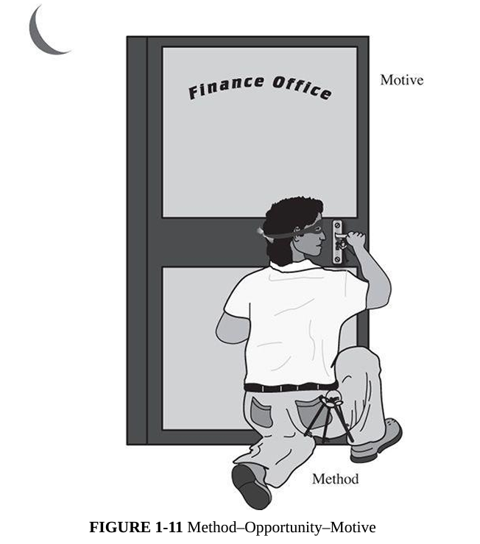
MOM

Slide 19
MOM : EVM – breaking
Method | - Skills and Knowledge: Understanding of EVM hardware and software, including operating systems, communication protocols, and cryptographic systems.
 | - Tools: Specialized hardware (e.g., card readers, microcontrollers, or probes), software tools to analyze or reverse-engineer firmware, and pre-designed attack scripts available online.
 | - Resources: Access to programming manuals, technical specifications, and publicly available security research papers on EVMs.
 | - Attack Variants: Techniques like malware injection, side-channel attacks, or exploiting software/firmware vulnerabilities to alter results or compromise integrity.
Opportunity | - Access Points: Physical access during storage, transport, or voting; insider threats from technicians or election staff.
 | - System Weaknesses: Poorly implemented security protocols, use of default settings, lack of tamper-evident features, or absence of robust monitoring mechanisms during elections.
 | - Operational Gaps: Temporary loss of custody during transit, inadequate auditing of results, or lack of rigorous testing for vulnerabilities.
 | - Public Accessibility: In some cases, older or widely used EVM models are studied extensively, making their weaknesses well-known.
Motive | - Political: Altering election outcomes to favor specific candidates or parties.
 | - Financial: Bribes or monetary gains in exchange for compromising election integrity.
 | - Ideological: Disrupting democratic processes to undermine trust in governance or to promote political agendas.
 | - Reputation: Demonstrating technical prowess by hacking high-profile systems like EVMs.
 | - Sabotage: Creating confusion, delaying results, or delegitimizing election outcomes by spreading misinformation about the security of EVMs.

Slide 20
Methods of Defense
Prevent it, by blocking the attack or closing the vulnerability
Deter it, by making attack harder if not impossible
Deflect it, by making another target more attractive
Mitigate it, by making its impact less severe
Detect it, either as it happens or some time after the fact
Recover from its effects

Slide 21
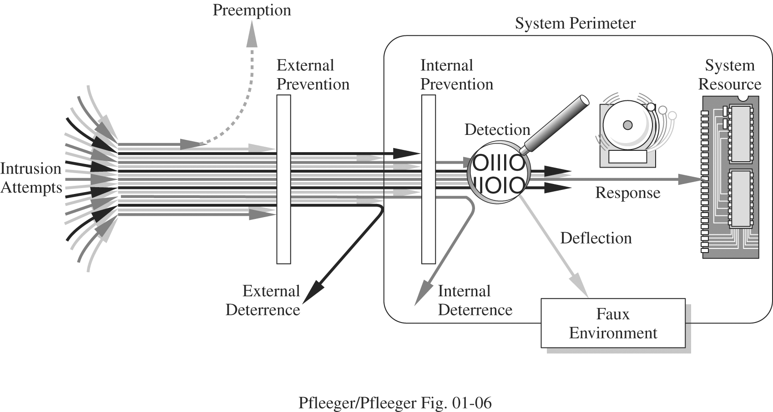

Slide 22
Methods of Defense
Controls
  Encryption
  Hardware Controls
    Hardware/smart card implementations of encryption
    Locks or cables limiting access
    Devices to verify users’ identity
    Firewalls
    Intrusion detection systems
  Software Controls
    Internal program controls,
    OS and Network system controls
    Independent control program (anti virus, passwords etc.)
    Development control
  Policies and Procedures
    Time restrictions
    Geofencing
    Standard development Environment
    Non Disclosure Agreement
  Physical Controls
    locks
    biometrics
    guards

Slide 23
Others Exposed Assets
Networks
  Network’s lack of physical proximity
  Use of insecure, shared media
  Inability to identify remote users positively
Access
  Computer time
  Malicious access
  Denial of service to legitimate user
Key People

Slide 24
Lab CA : Designing security Protocol
Group assignment with 4-5 max students in a group.
Open book test, Students can use college computers with internet disconnected
No personal gadgets will be permitted.

Slide 25
The Mysterious Death of Gerald Cotten and the Frozen Cryptocurrency Wallets
Gerald Cotten, the CEO of QuadrigaCX, a major cryptocurrency exchange, was responsible for managing the company’s funds. He held the private keys to multiple cryptocurrency wallets storing over $190 million worth of Bitcoin, Ethereum, and other assets. Cotten managed these wallets using a cold storage system—an offline mechanism designed to protect funds from hacking.
In December 2018, Cotten reportedly died while on a trip to India due to medical complications. His death left QuadrigaCX in a crisis because he was the only person who had access to the private keys. Without these keys, the cryptocurrency stored in the cold wallets became inaccessible, effectively locking users out of their funds.

Slide 26
Analysis
Security Goal | Achieved? | Explanation
Confidentiality | ✅ Yes | The funds remained secure and could not be accessed by unauthorized users.
Integrity | ✅ Yes | No unauthorized modifications were made to the funds.
Availability | ❌ No | The funds were permanently inaccessible due to the loss of private keys.
Authentication | ✅ Yes | Only Cotten had access, preventing unauthorized access.
Non-Repudiation | ❌ No | No formal recovery mechanism existed to prove ownership or retrieve the funds.

Slide 27
Attack | Possible? | Explanation
Single Point of Failure | ✅ Yes | Cotten was the only key holder, creating a centralized risk in a decentralized system.
Social Engineering | ✅ Possible | If Cotten shared keys with someone, they could steal the funds.
Key Management Failure | ✅ Yes | No key escrow or backup system was in place.
Phishing Attack | ❌ No | Since Cotten stored keys offline, online phishing was unlikely.
Brute Force Attack | ❌ No | Strong cryptographic security made brute-force attempts impractical.
Insider Attack | ✅ Possible | If someone had access to Cotten’s encrypted backups, they could attempt to recover the funds.

Slide 28
Real life cases of security violation and how they could have been prevented…

Slide 29
The Uber vs. Waymo Case (2017)
Anthony Levandowski, a former engineer at Google’s self-driving car division (Waymo), downloaded 14,000 confidential files before leaving the company.
He started his own self-driving truck company, Otto, which was later acquired by Uber.
Waymo sued Uber for stealing trade secrets related to LiDAR technology (a key self-driving component).
Uber settled for $245 million in stocks after a legal battle.

Slide 30
Probable solutions
Security Goal | How it Could Have Prevented the Espionage?
Confidentiality | Strong access controls and data encryption could have prevented Levandowski from stealing the files.
Integrity | File tracking and change monitoring systems could have detected unusual data transfers.
Authentication | Multi-factor authentication (MFA) could have restricted unauthorized access to sensitive files.
Non-Repudiation | Audit logs could have provided undeniable proof of who accessed the files and when.
Availability | Not directly relevant in this case.

Slide 31
Edward Snowden NSA Leak (2013)
Edward Snowden was a contractor for the National Security Agency (NSA). He had access to highly classified surveillance programs that tracked global digital communications.
What Happened?
  Snowden downloaded thousands of classified NSA files without being detected.
  He leaked details of global surveillance programs like PRISM, which collected data from Google, Facebook, and Apple.
  The leaks sparked global debates on privacy vs. national security.

Slide 32
Security Goals Analysis
Goal | Achieved? | Explanation
Confidentiality | ❌ No | Sensitive NSA files were exposed to the public.
Integrity | ✅ Yes | The data was not modified, only leaked.
Availability | ✅ Yes | NSA operations were not disrupted.
Authentication | ✅ Yes | Snowden had legal access but misused it.
Non-Repudiation | ❌ No | Weak tracking allowed Snowden to exfiltrate data undetected.

Slide 33
Classical Attack Analysis
Attack Type | Possible? | Explanation
Insider Attack | ✅ Yes | Snowden was an authorized user who misused his access.
Privilege Abuse | ✅ Yes | He accessed far more classified documents than needed.
Prevention Measures
✅ Zero Trust Security – Constant verification of access requests.
✅ Role-Based Access Control (RBAC) – Restrict employees to only necessary information.
✅ Digital Watermarking – Trace leaks by embedding invisible tracking in documents.

Slide 34
Netflix's "Orange Is the New Black" Ransom Leak (2017)
In 2017, a hacker group known as The Dark Overlord (TDO) infiltrated the systems of Larson Studios, an audio post-production company collaborating with major studios, including Netflix. TDO exfiltrated unreleased episodes of the fifth season of "Orange Is the New Black" and demanded a ransom for withholding their release.
Sequence of Events
  Initial Breach: TDO accessed Larson Studios' servers, obtaining numerous unreleased TV episodes and movies.
  Ransom Demand: The group demanded 50 Bitcoin (approximately $67,000 at the time) from Larson Studios, threatening to release the content if unpaid.
  Negotiation Breakdown: Despite initial agreements, Larson Studios did not fulfill the payment. TDO then approached Netflix with a similar ransom demand.
  Public Leak: After Netflix refused to comply, TDO released the first ten episodes of the season online ahead of the official release date.

Slide 35
Security Goals Analysis
Security Goal | Status | Explanation
Confidentiality | ❌ Compromised | Unauthorized access and release of unreleased episodes.
Integrity | ✅ Maintained | The content was released without alterations.
Availability | ✅ Maintained | Netflix's services remained operational; only the confidentiality of specific content was affected.
Authentication | ❌ Compromised | Inadequate access controls allowed unauthorized entry into Larson Studios' systems.
Non-Repudiation | ❌ Compromised | Lack of robust logging made it difficult to trace the breach accurately.

Slide 36
Attack Analysis
Insider Threat: Potential exploitation of internal access privileges or weak security protocols within Larson Studios.
Supply Chain Attack: Targeting a third-party vendor (Larson Studios) to compromise the primary entity (Netflix).
Preventive Measures
  Enhanced Vendor Security: Implement stringent security requirements and regular audits for third-party vendors.
  Robust Access Controls: Enforce strict authentication mechanisms and limit access based on necessity.
  Comprehensive Monitoring: Deploy advanced intrusion detection systems to identify and respond to unauthorized activities promptly.

Slide 37
Protocol Design

Slide 38
Secure Communication Protocol for Defense Communication System
Scenario: A country has four major bases near the border. Each base communicates with headquarters (HQ) for reporting findings and receiving orders. The protocol ensures confidentiality, integrity, authenticity, and accountability while using RSA for asymmetric encryption and AES for symmetric encryption.

Slide 39
1. Protocol Objectives
Confidentiality: Ensure only authorized recipients can read messages.
Integrity: Prevent unauthorized modification of messages.
Authentication: Verify sender and receiver, both identities.
Accountability: Track all communications to prevent repudiation.
Availability: Ensure continuous operation despite adversarial disruptions.

Slide 40
2. Cryptographic Components
ECDH/ KDC – Used for key exchange
RSA: Used for key encryption, short message encryption, digital signatures and authentication.
AES/DES: Used for encrypting and decrypting large message content.
SHA/hash algorithm: Used for hashing messages to ensure integrity.
Timestamps & Message IDs: Used to prevent replay attacks and improve traceability.

Slide 41
3. Entities
Headquarters (HQ) – Central command that receives reports and issues orders.
Base Stations (B1, B2, B3, B4) – Located near the border, reporting intelligence and executing commands.
Personnel (P1 to P8 in each base & HQ) – Military personnel authorized to send and receive messages.

Slide 42
Step 1: Key Generation & Distribution
Each base and HQ generates:
RSA Key Pair:
  Private Key (d) – Kept secret by each entity.
  Public Key (P) – Shared with HQ and other bases via a secure channel.
AES/DES Key for Each Session:
  A new random AES/DES key is generated for each communication session.
  This AES/DES key is encrypted using RSA before transmission.
All personnel are issued a digital certificate signed by HQ to authenticate messages.

Slide 43
Step 2: Sending a Secure Report from Base to HQ
The base creates a surveillance report M, a Report ID to track messages, a timestamp T to prevent replay attacks
Prepare message for transmission – use encryption, hash, digital sign
e.g.
H=SHA(M+T+Report ID)
S=Sign(H,d_{B}​) where d_{B} is sender’s private key
C=AES-Encrypt(K,M) where K is randomly generated session key
Kenc​=RSA-Encrypt(P_{HQ}​,K) encrypt K with HQ public key
Send {C+S+H+Kenc+T+Report ID} to HQ

Slide 44
Step 3: Receiving & Verifying at HQ
HQ decrypts K using its private RSA key:
K=RSA-Decrypt(dHQ,Kenc)
Use K to decrypt M:
M=AES-Decrypt(K,C)
3. Verify Integrity & Authenticity
Compute hash: H′=SHA(M∥T∥Report ID)
Verify signature using the base’s public key:
Verify(H′,S,PB)
If valid, store (M,ReportID,T,S in HQ’s secure database.

Slide 45
Step 4: Sending Orders from HQ to Bases
1. HQ formulates an encrypted command - M
2. Encrypt & Sign the command M
Compute hash H of C
HQ signs it using its private RSA key.
Encrypt message M using a random AES key K′
Encrypt K′ using base’s public RSA key.
3. Transmitting the Order
{Kenc+M+S+T+OrderID}
4. Base Verifies & Executes Order

Slide 46
Security Policies
Key Management:
  RSA private keys are never shared.
  AES keys are session-based for added security.
Message Retention:
  Reports and orders are stored for 6 months.
Access Control:
  Only authorized personnel with valid digital certificates can send messages.
Emergency Override:
  If keys are compromised, HQ revokes keys and issues new RSA keys.
Tamper Detection:
  Invalid or modified messages are rejected and logged for review.
Transmission
  Both parties are required to use Public private key pairs to avoid non-repudiation on both sides

Slide 47
IA III- Security Analysis of scenario

Slide 48
Classical – common attacks
Classical attacks on security:
  Eavesdropping
  Traffic Analysis attack
  Replay attack
  non-repudiation attack
  Man-in-the-Middle attack
  Data Tampering
  Denial of Service (DoS) attack
  Brute Force Attack
  zero day exploit attack,
  Phishing and social engineering
  Spoofing
  Malware
  session hijacking attack

Slide 49
Which of the attacks are possible and which are not?
Dictionary-Based Encryption Weakness
Plaintext Leakage for Unknown Words
No Padding and Fixed Message Length- correlates to the content, also someone can infer structural patterns
Predictable Transmission Timing
Shared AES-128 Key (Single Key for All)

Slide 50
Potential Attacks
Frequency Analysis Attack – Since dictionary words always encrypt to the same ciphertext, an attacker can gradually map encrypted words to their plaintext equivalents.
Known-Plaintext Attack – If an attacker has access to past reports or similar texts, they can match ciphertext patterns to known plaintext words.
Ciphertext Replay Attack – Since reports are sent daily and follow a structured format, an attacker could try to resend past encrypted reports to manipulate responses.
Traffic Analysis Attack – By observing message sizes and timestamps, an attacker could infer the nature of the report without decrypting it.

Slide 51
A company uses an RFID-based employee badge system for office access. The system does not implement challenge-response authentication. Employees scan their badges to enter the building, and the system verifies their access based on the scanned data. However, an attacker with an RFID scanner can capture the signal from an employee’s badge and replay it later to gain unauthorized entry.
The system has the following characteristics:
  Each employee has an RFID badge with a unique identifier.
  The badge transmits the same signal each time it is scanned.
  The system does not track repeated badge use within a short timeframe.
Identify and analyze the security vulnerabilities in this system. What attacks could be performed against it? Suggest modifications to enhance the security of the access control system.

Slide 52
Authentication Attack on Employee Web Portal
Analyze the security scenario:
A company provides employees access to a web-based portal using a username and password. The system does not implement multi-factor authentication (MFA) or account lockout mechanisms. Attackers attempt to gain unauthorized access through brute-force and credential-stuffing attacks.
The system has the following characteristics:
  User authentication is based solely on a username and password.
  There is no MFA (e.g., SMS or app-based verification).
  There are no restrictions on the number of failed login attempts.
  The portal does not enforce strong password policies.
Evaluate the vulnerabilities in the authentication mechanism. What attack techniques could be used against it? Propose improvements to enhance security and prevent unauthorized access.

Slide 53
Unauthorized Access Due to Shared Credentials in a Research Lab
Analyze the security scenario:
A university research lab allows multiple researchers to use a single shared administrative account to access a central database. A former researcher, who was not removed from the system, continues accessing confidential data without authorization.
The system has the following characteristics:
  A single set of shared credentials is used by all researchers.
  There is no individual authentication or user tracking.
  The system does not have an automatic account deactivation mechanism.
  No audit logs are maintained to track user activity.
Analyze the security risks in this access management system. What potential threats arise from shared credentials? Recommend strategies to secure the system and prevent unauthorized access.

Slide 54
Data Modification in an IoT-Based Smart Lock System
Analyze the security scenario:
A smart home security system allows users to lock and unlock their doors remotely using a mobile app. The commands are sent over an unencrypted communication channel, making it possible for an attacker to intercept and modify messages.
The system has the following characteristics:
  Commands such as "lock door" and "unlock door" are transmitted in plaintext.
  No encryption or message integrity verification is used.
  The system does not check for tampering or replayed messages.
  Any intercepted command can be modified and replayed by an attacker.
Identify the security vulnerabilities in this system. What attack techniques could be used against it? Suggest cryptographic measures to ensure the confidentiality and integrity of the commands.

Slide 55
Replay Attack on OTP-Based Online Banking Authentication
Analyze the security scenario:
An online banking system uses one-time passwords (OTPs) sent via SMS for transaction verification. However, OTPs remain valid for five minutes, allowing attackers to intercept and reuse them.
The system has the following characteristics:
  OTPs are sent via SMS and remain valid for five minutes.
  No additional authentication (e.g., biometric verification) is required for transactions.
  The system does not track repeated OTP use.
  An attacker with access to intercepted OTPs can replay them before expiration.
Evaluate the security flaws in this OTP-based authentication system. What risks arise from SMS-based OTP authentication? Propose solutions to mitigate replay attacks and strengthen transaction security.

Slide 56
Authentication Attack Due to Exposed API Keys in Cloud Services
Analyze the security scenario:
A cloud storage provider allows users to authenticate via API keys. Developers store these API keys in configuration files, but one developer accidentally commits a file containing an API key to a public GitHub repository. Attackers extract the API key and gain full access to private storage.
The system has the following characteristics:
  API authentication relies solely on API keys stored in configuration files.
  There is no mechanism to detect or prevent key exposure.
  The API key does not expire or rotate automatically.
  The system lacks IP allowlisting or usage restrictions.
Identify the security weaknesses in this authentication system. How could attackers exploit exposed API keys? Recommend secure authentication mechanisms for protecting API-based services.

Slide 57
Unauthorized Access Due to Poor Session Management in E-commerce Websites
Analyze the security scenario:
An e-commerce website uses authentication tokens stored in browser cookies to maintain user sessions. However, these session tokens do not expire, allowing an attacker to hijack an active session indefinitely.
The system has the following characteristics:
  Users remain logged in unless they manually log out.
  Session tokens do not expire automatically.
  No additional verification is required for high-value transactions.
  An attacker who steals a session token via cross-site scripting (XSS) can reuse it indefinitely.
Analyze the vulnerabilities in this session management approach. What attacks could be performed against this system? Propose security enhancements to protect user sessions.

Slide 58
Data Modification in Industrial Control Systems (ICS)
Analyze the security scenario:
A water treatment plant allows remote monitoring and control of industrial processes. However, the system lacks encryption and secure authentication for remote access. Attackers intercept and modify control commands, altering chemical levels in the water supply.
The system has the following characteristics:
  Control commands are transmitted in plaintext.
  No authentication or integrity verification is implemented for remote access.
  Attackers can manipulate intercepted commands to change process parameters.
  Unauthorized modifications can lead to serious safety risks.
Examine the security risks in this industrial control system. What types of attacks could be executed against it? Suggest measures to ensure the confidentiality, integrity, and authentication of control commands.

Slide 59
Questions?

